Slide 1

Credit Card Fraud Detection Analysis
A data-driven approach to minimizing financial loss while maintaining customer trust
AUTHOR: MICHELLE MWENDE

Slide 2

Business Challenge
Financial Risk
Competing Priorities
Legacy Systems
Credit card fraud causes direct monetary losses and erodes customer trust
Balance detecting fraud (false negatives) vs. blocking legitimate transactions (false positives)
Static rules struggle to adapt to evolving fraud patterns

Slide 3
Project Objectives
01
02
Explore Transaction Patterns
Address Class Imbalance
Understand fraudulent vs. non-fraudulent behavior through EDA
Assess impact on fraud detection performance
03
04
Build Classification Models
Optimize Performance
Compare multiple approaches for identifying fraud
Balance false positives and false negatives to minimize expected loss

Slide 4

Dataset Overview
284,807 Transactions
0.17%
578:1
European cardholders over two days in September 2013
31 numerical features (V1-V28 PCA-transformed, Time, Amount)
Fraudulent
Imbalance Ratio
Only 492 fraud cases
Extreme class imbalance
Highly anonymized for confidentiality
Clean dataset with no missing values

Slide 5

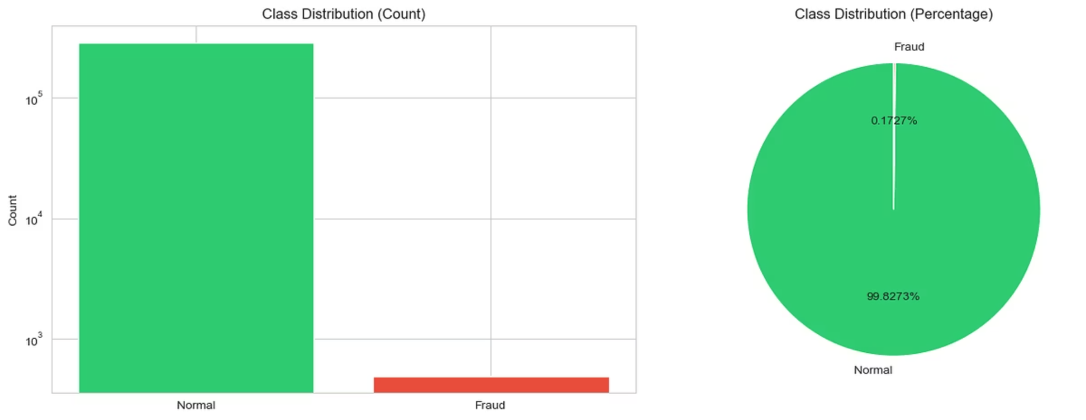
The Imbalance Challenge
With 99.83% legitimate transactions, traditional accuracy metrics are misleading. A model predicting all transactions as legitimate would achieve 99.83% accuracy while detecting zero fraud.

Slide 6




Data Preparation Strategy
Feature Scaling
Train-Test Split
Imbalance Handling
Standardized Time and Amount features while preserving PCA-transformed variables
80-20 split with stratification to maintain fraud distribution
Tested SMOTE, undersampling, and class weights

Slide 7

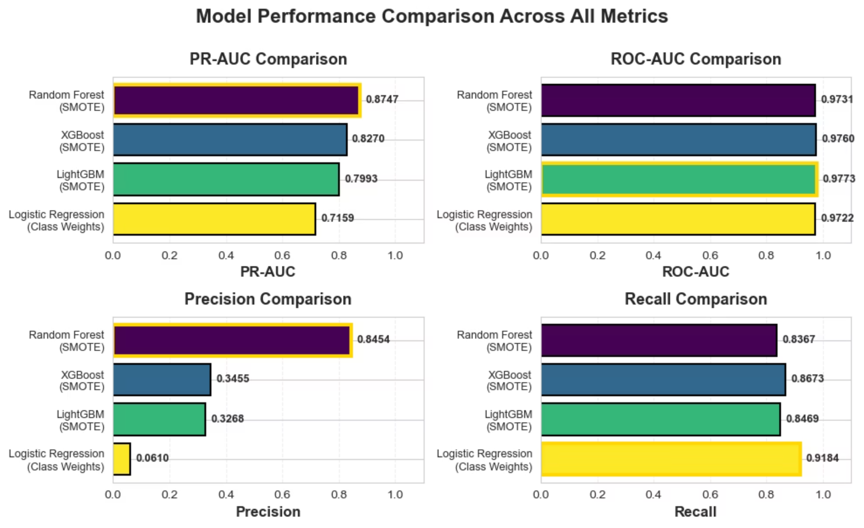
Model Performance Comparison
Random Forest with SMOTE emerged as the clear winner, achieving the highest PR-AUC of 0.8747 and best balance between precision and recall.

Slide 8
The Winning Model
Random Forest + SMOTE
Why This Model Wins
Only 15 false positives vs. 1,386 for Logistic Regression
84.5%
Caught 82 out of 98 fraudulent transactions
Precision
Optimal balance minimizes customer disruption
Highest PR-AUC indicates superior performance on imbalanced data
83.7%
Recall
0.87
PR-AUC

Slide 9
Key Findings & Business Impact
Feature Importance
Threshold Optimization
V14, V10, V4, V12, and V17 are the primary fraud indicators, accounting for over 60% of predictive power
Lowering threshold to 0.35 increased recall to 89.8% while maintaining 76.5% precision—catching 11% more fraud
Operational Efficiency
Customer Experience
Reduced false alarms by 99% compared to baseline, dramatically lowering manual review costs
Minimized legitimate transaction blocks while maintaining robust fraud protection

Slide 10


Recommendations
Deploy Random Forest Model
Continuous Monitoring
Track model performance and retrain quarterly as fraud patterns evolve
Implement with 0.35 threshold for optimal fraud detection and customer experience balance
System Integration
Cost-Benefit Analysis
Integrate with real-time transaction processing for immediate fraud flagging
Regularly assess financial impact and adjust threshold based on business priorities

Slide 11

Thank You
Your time and attention are greatly appreciated. We hope this analysis provides valuable insights into enhancing our fraud detection capabilities and protecting our customers. For any questions or further discussion, please feel free to reach out.
Michelle Mwende

